Slide 1
DECODER
A decoder is a logic circuit that accepts a set of inputs that represents a binary number and activates only the output that corresponds to the input number.
In other words, a decoder circuit looks at its inputs, determines which binary number is present there, and activates the one output that corresponds to that number ; all other outputs remain inactive

Slide 2
In its general form, a decoder has N input lines to handle N bits and form one to 2 ^{N} output lines to indicate the presence of one or more N-bit combinations.
The basic binary function
An AND gate can be used as the basic decoding element
because it produces a HIGH output only when all inputs are
HIGH
Refer next slide for example

Slide 3
Decoders

Slide 4
Decoders
Binary decoder
2-bit decoder
3-bit decoder
BCD-to-decimal decoder
BCD-to-Seven-Segment Decoder

Slide 5
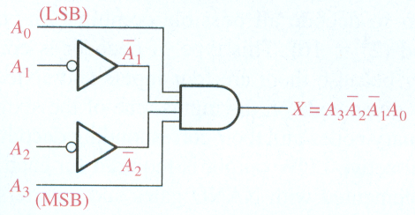
Decoders
Binary decoder
  The output is 1 only when:
    A₀ = 1
    A₂ = 0
    A₃ = 0
    A₄ = 1
This is only one of an infinite number of examples

Slide 6

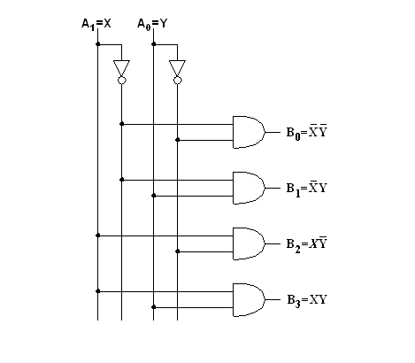
2 To 4 Line Decoder

Slide 7
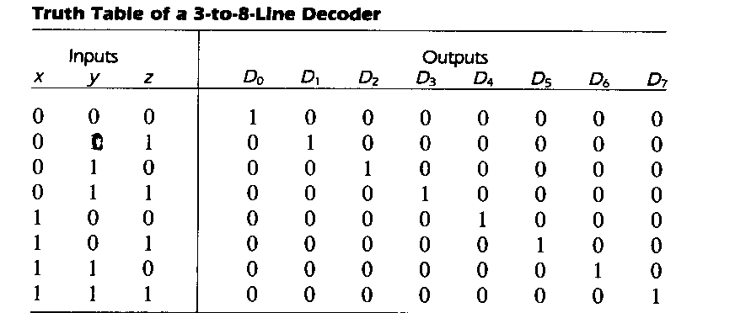
3 To 8 Line Decoder

Slide 8
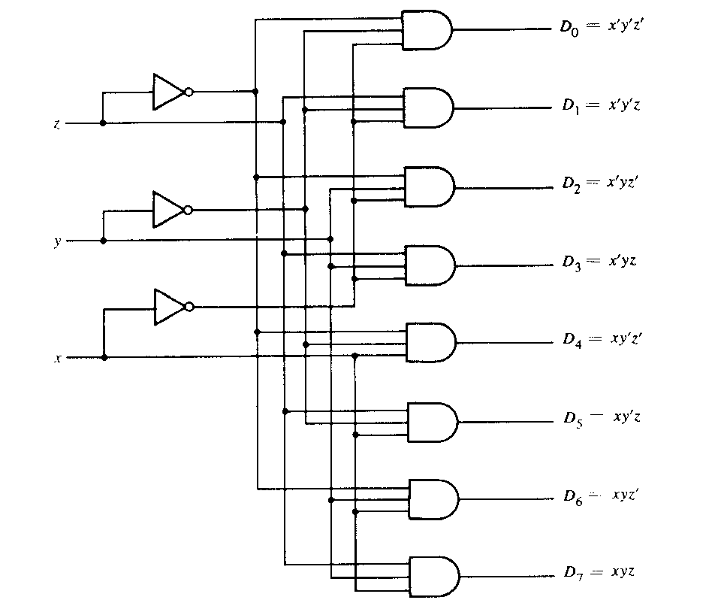

Slide 9
BCD-to-Seven-Segment Decoder
Specification
  Digital readouts on many digital products often use LED seven-segment displays.
  Each digit is created by lighting the appropriate segments. The segments are labeled a,b,c,d,e,f,g
  The decoder takes a BCD input and outputs the correct code for the seven-segment display.
9/15/09 - L12 Combinational Logic Design
Copyright 2009 - Joanne DeGroat, ECE, OSU

Slide 10
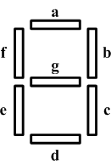
Specification
Input: A 4-bit binary value that is a BCD coded input.
Outputs: 7 bits, a through g for each of the segments of the display.
Operation: Decode the input to activate the correct segments.
9/15/09 - L12 Combinational Logic Design
Copyright 2009 - Joanne DeGroat, ECE, OSU

Slide 11
Example 3 (cont.)
Step 2 (Formulation)
 | BCD Input |  |  |  | 7 Segment Decoder
Decimal | A | B | C | D | a | b | c | d | e | f | g
0 | 0 | 0 | 0 | 0 | 1 | 1 | 1 | 1 | 1 | 1 | 0
1 | 0 | 0 | 0 | 1 | 0 | 1 | 1 | 0 | 0 | 0 | 0
2 | 0 | 0 | 1 | 0 | 1 | 1 | 0 | 1 | 1 | 0 | 1
3 | 0 | 0 | 1 | 1 | 1 | 1 | 1 | 1 | 0 | 0 | 1
4 | 0 | 1 | 0 | 0 | 0 | 1 | 1 | 0 | 0 | 1 | 1
5 | 0 | 1 | 0 | 1 | 1 | 0 | 1 | 1 | 0 | 1 | 1
6 | 0 | 1 | 1 | 0 | 1 | 0 | 1 | 1 | 1 | 1 | 1
7 | 0 | 1 | 1 | 1 | 1 | 1 | 1 | 0 | 0 | 0 | 0
8 | 1 | 0 | 0 | 0 | 1 | 1 | 1 | 1 | 1 | 1 | 1
9 | 1 | 0 | 0 | 1 | 1 | 1 | 1 | 0 | 0 | 1 | 1
10-15 | All Other Inputs |  |  |  | 0 | 0 | 0 | 0 | 0 | 0 | 0
Invalid BCD codes
=
No Light
Ahmad Almulhem, KFUPM 2010

Slide 12
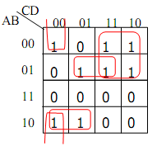
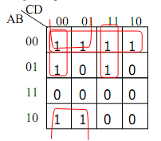
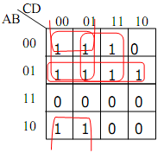
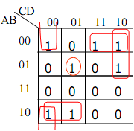
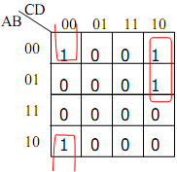
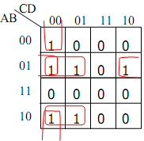
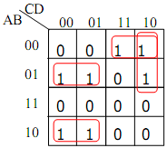
Example 3 (cont.)
Step 3 (Optimization)
a
b
c
d
e
f
g
Ahmad Almulhem, KFUPM 2010

Slide 13
Example 3 (cont.)
Step 3 (Optimization) (cont.)
a = A’C + A’BD + AB’C’ + B’C’D’
b = A’B’ + A’C’D’ + A’CD + B’C’
c = A’B + B’C’ + A’C’ + A’D
d = A’CD’ + A’B’C + B’C’D’+AB’C’+A’BC’D
e = A’CD’ + B’C’D’
f = A’BC’ + A’C’D’ + A’BD’ + AB’C’
g = A’CD’ + A’B’C + A’BC’ + AB’C’
Exercise: Draw the circuit
Ahmad Almulhem, KFUPM 2010

Slide 14
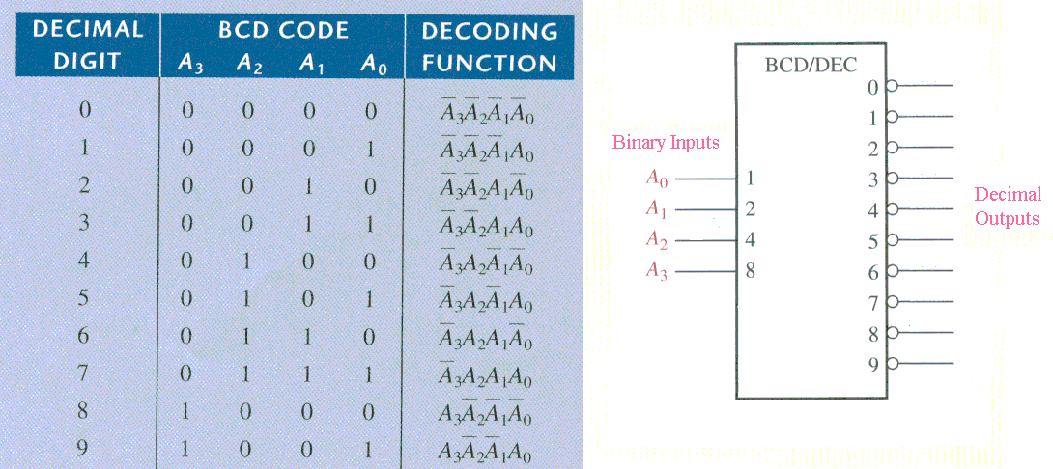
Decoders
BCD-to-decimal decoder

